Slide 1
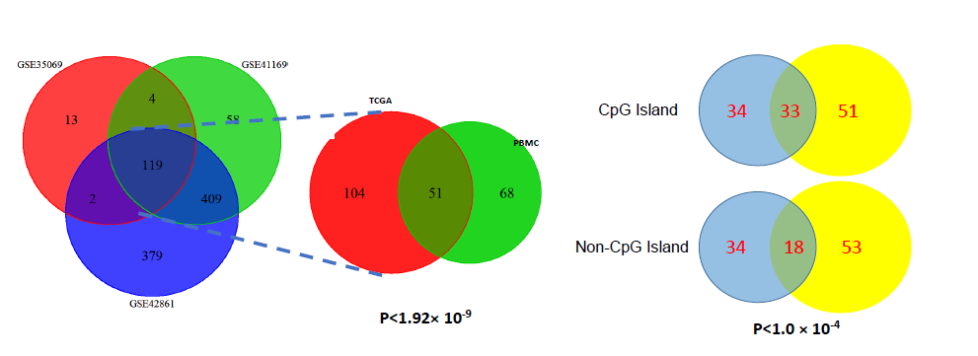
Supplementary Figures and Legends
Supplementary Figure 1. Methylation Haplotype Block in HM450 beadchip
Methylation haplotype block were inferred in different HM450K dataset and the overlap between the dataset were test whether these regions were over-representated. Meanwhile, the influence from CpG island were also investigated.

Slide 2
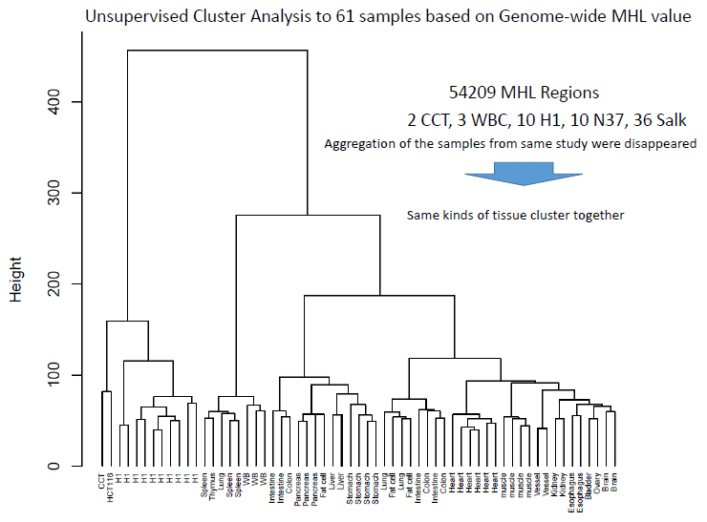
Supplementary Figure 2. Cluster Analysis to all the GWBS samples.
All MHL regions were selected in heatmap analysis to investigate the tissue relationship. The Euclidean distance and Ward.D aggregation were applied in the cluster analysis(R, Clust package).

